Slide 1
Cigniti Automation Framework
Overview & Approach

Slide 2
Agenda
About Framework
Framework Components
Workflow of the Framework
Benefits of the Framework
Existing Automation Approach for OnDemand Module Test Cases Automation

Slide 3
About Framework
CAFT – CIGNITI AUTOMATION FRAMEWORK for TESTING
CAFT is a HYBRID Framework i.e. amalgamation of the features of Keyword Driven, Modular Driven, Data driven frameworks
The framework is flexible and scalable enough to support & automate any type of applications independent of any technology it’s designed on

Slide 4

Components of the Framework
Following are the components of a Hybrid Framework
Driver Script - It is a VBScript file that acts as the starting point for running your test scripts
Batch Sheet - Batch Sheet contains the list of all the test cases that you have automated. It also contains a column named “Execute” which contains values ‘Yes’ and ‘No’ or True /False The Driver Script reads this sheet and executes those test cases that are marked as ‘Yes’/True
In CAFT we have the Batch sheets categorized at two levels as shown below
Run-Manager – Main Sheet
Run-Manager – Module Level TC Sheet

Slide 5
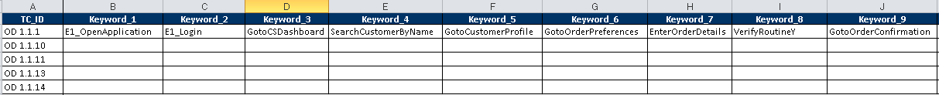
Components of the Framework Contd..
Test Case Flow Sheet - Each test case is divided into different business flows. So a test case will be completely executed only when all its flows have been executed

Slide 6
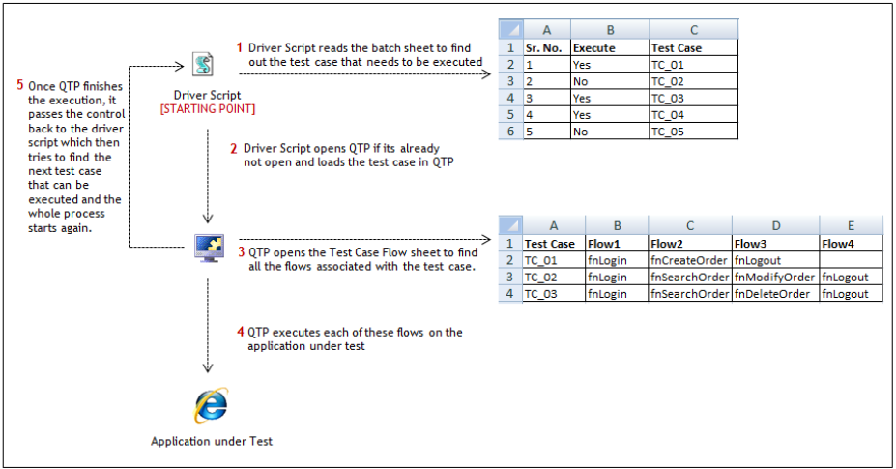
Workflow in Hybrid Framework

Slide 7
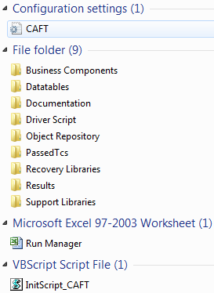
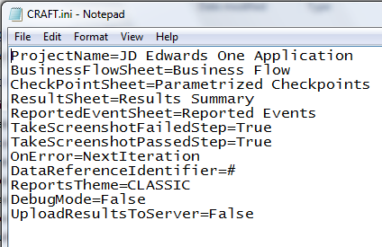
Folder Structure
CAFT.ini is a configuration file containing the various parameters & values for framework settings

Slide 8
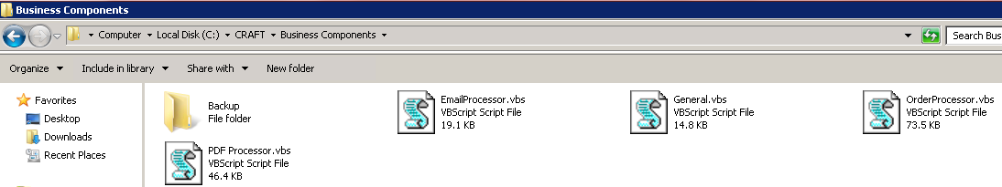
Folder Structure
Business components contains the reusable components that we can reuse in various Test Cases

Slide 9
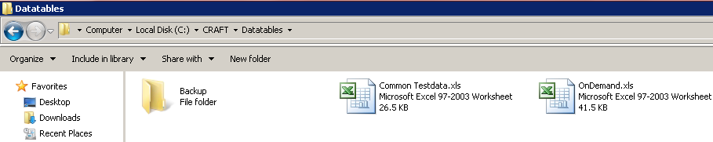
Folder Structure
  This folder contains all the Datatables of various modules of the application along with one “Common TestData” Datatable.
  Only keep those Datatables workbooks in the “Datatables” folder which needs to be executed and copy rest of the Datatable files in the Backup folder
  “Common TestData.xls” workbook contains general parameters for test execution and should be available in “Datatables” folder irrespective of the application module being executed

Slide 10
Folder Structure
  This folder contains Driver Script for CAFT Framework which controls and drives the entire framework execution.

Slide 11
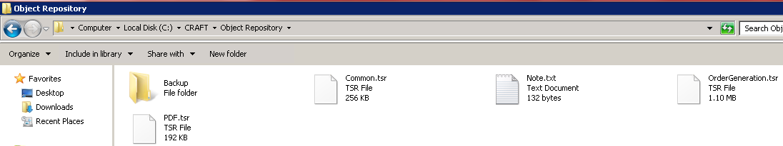
Folder Structure
  This folder contains all the Object Repository files (.tsr) of various modules of the application along with one Common Repository file
  Only keep those Object Repository files in the “Object Repository” folder which needs to be executed and copy rest of the object repository files in the Backup folder

Slide 12
Folder Structure
  This folder contains generic support function libraries having reusable functions

Slide 13
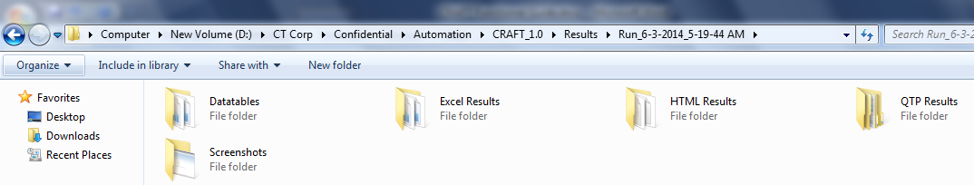
Folder Structure
  This folder contains Test Execution Results.
  The Test Results are stored in 3 formats i.e. “Excel”, “HTML” & “QTP”
  The screenshots are stored in “Screenshots” folder located under “Results” folder

Slide 14
Benefits of the Hybrid Framework
  The business components & function libraries are generic for entire application and can be reused to different Test Cases
  All the complexity is added in the function libraries & business components. Once the libraries/components are ready, it becomes very easy to write the actual test script steps in excel sheets
  Since the data is kept separate from the test script, the same script can be run multiple times for different sets of data (which can be kept in multiple rows in the data sheet).
  Changes made in the test data don’t affect the test scripts in any way and vice versa

